Slide 1
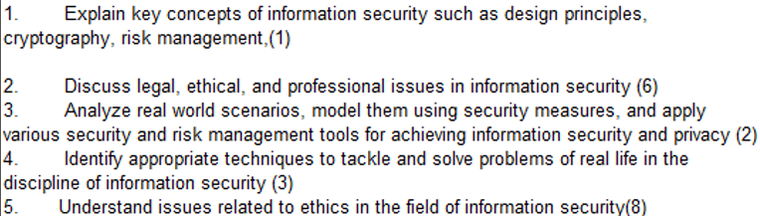
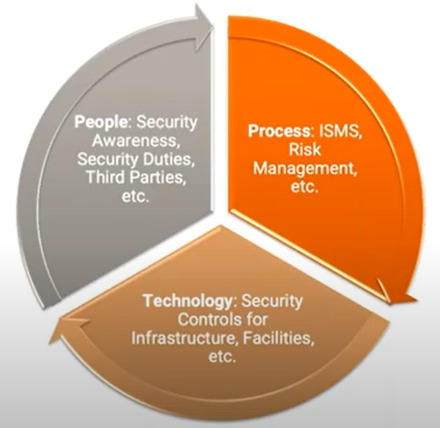
CS 3002 Information Security
Fall 2024
Week # 14 – Lecture# 37, 38, 39
19, 20 and 21 November 2024
Dr. Aqsa Aslam

Slide 2

CS-3002: Information Security
Lecture # 11: Network Security Protocols and Defensive Mechanisms (IDS, IPSEC, VPN)
Prof. Dr. Sufian Hameed
Department of Computer Science
FAST-NUCES

Slide 3
This Lecture
Intrusion Detection System (IDS)
IPSEC
Virtual Private Network

Slide 4
Intrusion Detection

Slide 5
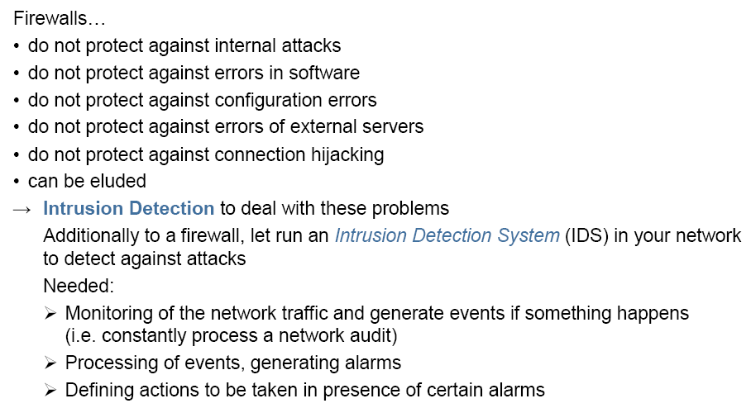
Intrusion Detection

Slide 6
Intrusion detection
Many intrusion detection systems
Close to 100 systems with current web pages
Network-based, host-based, or combination
Two basic models
Misuse detection model
Maintain data on known attacks
Look for activity with corresponding signatures
Anomaly detection model
Try to figure out what is “normal”
Report anomalous behavior
Fundamental problem: too many false alarms

Slide 7
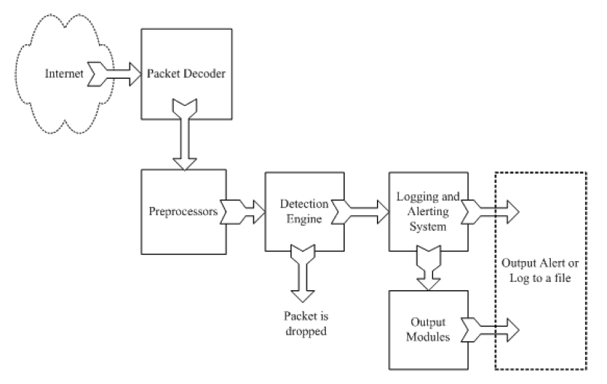
Example: Snort
http://www.snort.org/
From: Rafeeq Ur Rehman, Intrusion Detection Systems with Snort: Advanced IDS Techniques with Snort, Apache, MySQL, PHP, and ACID.

Slide 8
Snort components
Packet Decoder
input from Ethernet, SLIP, PPP…
Preprocessor:
detect anomalies in packet headers
packet defragmentation
decode HTTP URI
reassemble TCP streams
Detection Engine: applies rules to packets
Logging and Alerting System
Output Modules: alerts, log, other output

Slide 9
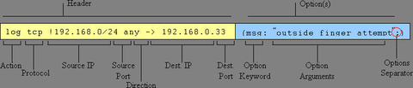
Snort detection rules
rule header
rule options

Slide 10
Snort challenges
Misuse detection – avoid known intrusions
Database size continues to grow
Snort version 2.3.2 had 2,600 rules
Snort spends 80% of time doing string match
Anomaly detection – identify new attacks
Probability of detection is low

Slide 11
Difficulties in anomaly detection
Lack of training data
Lots of “normal” network, system call data
Little data containing realistic attacks, anomalies
Data drift
Statistical methods detect changes in behavior
Attacker can attack gradually and incrementally
Main characteristics not well understood
By many measures, attack may be within bounds of “normal” range of activities
False identifications are very costly
Sys Admin spend many hours examining evidence

Slide 12
TCP Protocol Stack
Application protocol
Application
Application
Transport
TCP protocol
Transport
Network
IP protocol
IP
IP protocol
Network
Link
Data Link
Network Access
Data Link
Link

Slide 13
Recall packet formats and layers
TCP Header
Application
Application message - data
message
Transport (TCP, UDP)
segment
TCP
data
TCP
data
TCP
data
Network (IP)
packet
IP
TCP
data
Link Layer
frame
ETH
IP
TCP
data
ETF
IP Header
Link (Ethernet)
Header
Link (Ethernet)
Trailer

Slide 14
IPSEC

Slide 15
IETF IPSec Working Group
The basic Internet Protocol (IP) has absolutely no security concepts integrated
Data are transferred in plain text
Authentication is not possible, everybody can fake the IP sender address or modify the payload of a packet
Thus: specification of a security architecture for IP that comprises authentication and encryption mechanism
Security mechanisms should be algorithm-independent, cryptographic algorithms can be altered without effecting other parts of the protocol
Wide variety of security policies should be supported
Result:
Compatibility with the Internet structure as given by IPv4 was needed to introduce security functions earlier than the “rest” of IPv6
Thus: in 1992 the IP Security Protocol (IPSec) was standardized, together with theInternet Key Exchange (IKE)

Slide 16
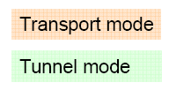
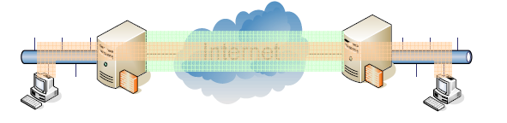
IP Security Protocol (IPSec)
Security design goal: authentication and encryption
Authentication Header (AH): provides connectionless data integrity and data origin authentication for IP datagrams and provides protection against replay attacks
Encapsulation Security Payload (ESP): provides confidentiality, connectionless integrity, data-origin authentication, an anti-replay service (a form of partial sequence integrity), and limited traffic-flow confidentiality
Both mechanism are based on the concept of a security association (SA) and may be used together or separately
Work modes:
Transport mode
Build a point-to-point connection between two hosts
Tunnel mode
Connect two “security gateways”, i.e. whole networks. Security gateways can be integrated with the access routers of the networks

Slide 17
Security Associations (SA)
A security association is an agreement between two or more parties regarding security services that they want to use and how they are going to provide them
This agreement is established through a common set of security related parameters like
Authentication algorithm, mode and keys for the AH
Encryption algorithm, mode, and keys for the ESP
An initialization vector (IV), if necessary
Lifetime of the keys and the SA as a whole
Source address
Security level of the protected data, such as confidential, secret or unclassified
When an IP packet is received, it can only be authenticated and/or decrypted if the receiver can link it with an appropriate SA. Hence the IP packet must convey a reference that points to the SA on the receiver's side
In IPSec this reference is called a security parameter index (SPI)
Each SA is uniquely identified by a destination address and a SPI value negotiated before communication by the Internet Key Exchange (IKE) protocol

Slide 18
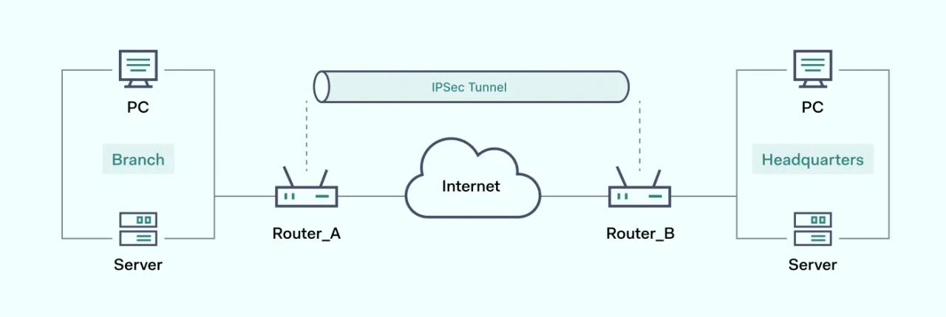
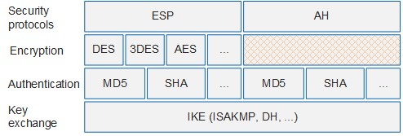
IP Security Protocol (IPSec)
IPsec framework

Slide 19
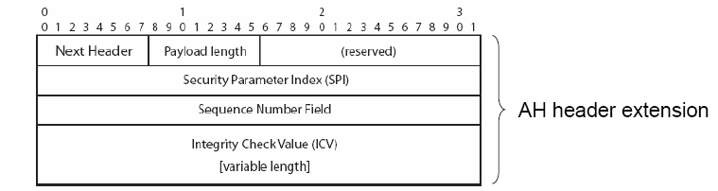
Authentication Header (AH)
AH provides sender authentication and data integrity for IP packets by enhancing the IP header with some additional fields:
Next Header: type of the following header after the AH (as the protocol field in IPv4)
Payload Length: length of the integrity check value (ICV) in 32-bit words
Reserved: for future use, currently set to zero
SPI: identifies the SA for the IP packet on receiver side
Sequence number: assign each packet an unique identifier to protect against replay attacks
ICV: the assigned authentication/integrity value

Slide 20
Integrity Check Value
The authentication data mostly is computed by using a cryptographic authentication algorithm and a corresponding secret key
Use a one-way hash function, MD5 is default in IPSec
The ICV in case of MD 5 is a 128-bit hash value from the concatenation of the key, the message, and the key again
Alternative: use digital signatures from public key cryptography
In general, the authentication algorithm is negotiated as part of the SA
The receiver uses the same algorithm to test the ICV
Problem: some fields of the IP packet header change in transit, e.g. the TTL field in IPv4
The ICV is computed for a whole IP packet
With another TTL, the receiver comes to another ICV as the sender
Thus, the receiver has to set such information like TTL back to the initial value before computing and testing the ICV value
Note: AH does not encrypt the payload!

Slide 21
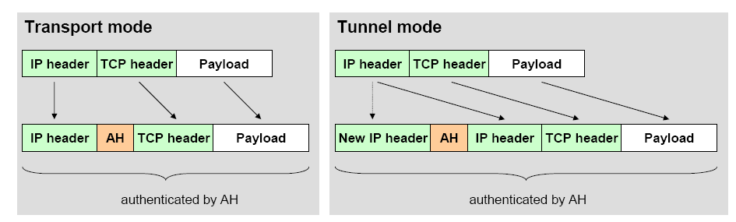
Use of the Authentication Header
AH can be used in two ways:
In general, AH has the following characteristics
Advantage: AH mechanism does not significantly increase implementation costs
Disadvantage: AH increases IP processing costs and communication latency in participating systems

Slide 22
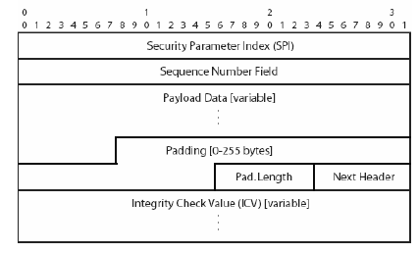
Encapsulating Security Payload (ESP)
ESP provides data confidentiality by using encryption and encapsulation and adding an ESP header/trailer to an IP packet:
SPI, Sequence Number, and ICV (only if integrity is also checked): as in AH
Payload data: encrypted with an algorithm defined in the SA (default: DES in CBC mode)
Padding: filled with random bits
Padding Length: indicates the total length of the Padding field
Next header: identifies the following header

Slide 23
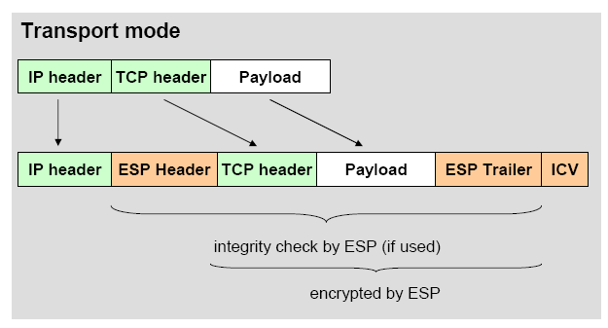
Use of the Encapsulating Security Payload
ESP can be used in two ways, as AH:
The receiver processes the IP header and plaintext part of the ESP to obtain the SPI value
This value is used as an index for a local SPI table to find the negotiated SA parameters and cryptographic keys to decrypt the rest of the packet

Slide 24
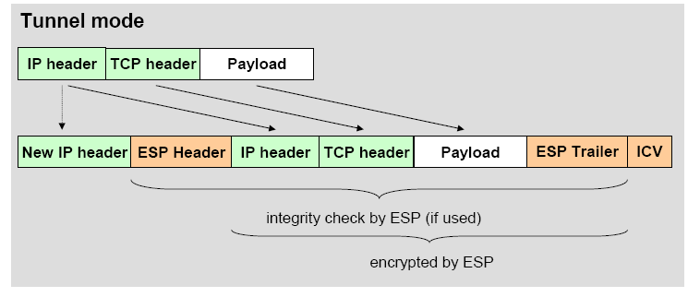
Use of the Encapsulating Security Payload
In tunnel mode, an encrypted tunnel between two security gateways is installed
Used e.g. between two LANs which should communicate in a secure manner (as in VPN, Virtual private Network)

Slide 25
Internet Key Exchange (IKE)
Before applying AH and/or ESP, a SA has to be established – this is done using the
Internet Key Exchange (IKEv2) in two phases:
Phase 1: negotiate a SA in two steps
Purpose: mutual authentication, establish secret keys for phase 2
Phase 2: create multiple SAs used for one communication each
Purpose: from the results of phase 1, several SAs can be generated, which gives a speedup (if several SAs are needed)

Slide 26
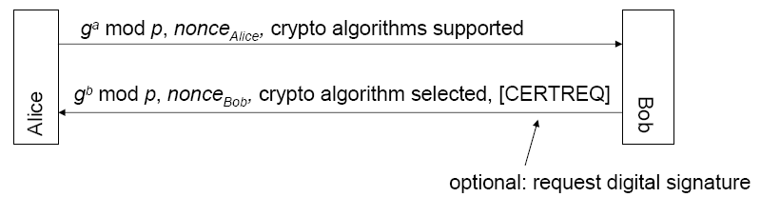
IKE Phases
First half of phase 1: establish a common secret using Diffie-Hellman key exchange:
Second half of phase 1: mutual authentication
Using the key negotiated by Diffie-Hellman, now encrypted mutual authentication is done – optionally by using certificates, if requested before
In the authentication messages, also IP addresses and TCP ports of communication partners are included
IKE phase 2: applied after mutual authentication.
Use negotiated key to propose/accept SAs – maybe also by doing a new key exchange with every SA proposal to generate new session keys

Slide 27
Virtual Private Networks (VPN)

Slide 28
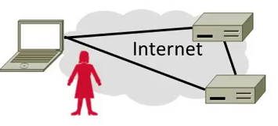
Topic
Virtual Private Networks (VPNs)
Run as closed (private) networks on Internet
Use IPSEC to secure messages

Slide 29
Motivation
The best part of IP connectivity
You can send to any other host
The worst part of IP connectivity
Any host can send packets to you!
There’s nasty stuff out there …

Slide 30
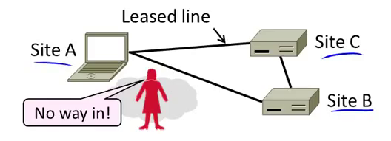
Motivation (2)
Often desirable to separate network from the Internet, e.g., a company
Private network with leased lines
Physically separated from Internet

Slide 31
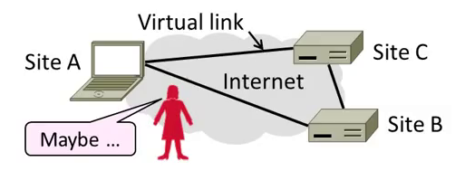
Motivation (3)
Idea: Use the public Internet instead of leased lines – cheaper!
Logically separated from Internet …
This is a Virtual Private Network (VPN)

Slide 32
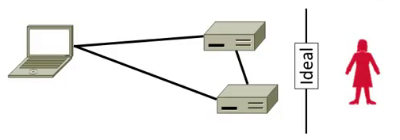
Goal and Threat Model
Goal is to keep a logical network (VPN) separate from the Internet while using it for connectivity
Threat is EVE may access VPN and intercept or tamper with messages

Slide 33
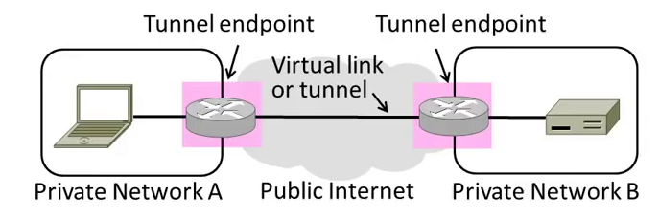
Tunneling
How can we build a virtual link? With tunneling!
Hosts in private network send to each other normally
To cross virtual link (tunnel), endpoints encapsulate packet

Slide 34
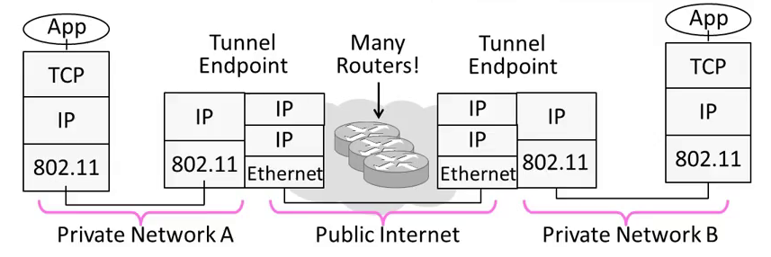
Tunneling (2)
Tunnel endpoints encapsulate IP packets (“IP in IP”)
Add/modify outer IP header for delivery to remote endpoint

Slide 35
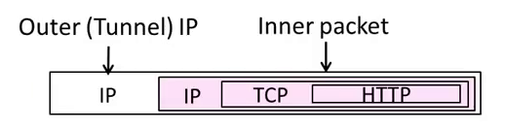
Tunneling (3)
Simplest encapsulation wraps packet with another IP header
Outer (tunnel) IP header has tunnel endpoints as source/destination
Inner packet has private network IP addresses as source/destination

Slide 36
Tunneling (4)
Tunneling alone is not secure …
No confidentiality, integrity/ authenticity
EVE can read, inject her own messages
We require cryptographic protections!
IPSEC (IP Security) is often used to secure VPN tunnels

Slide 37
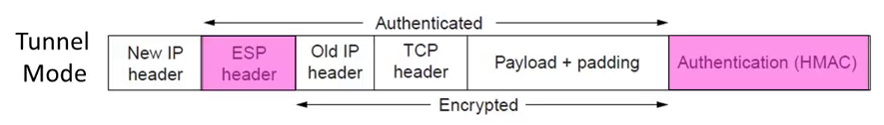
IPSEC (IP Security)
Longstanding effort to secure the IP layer
Adds confidentiality, integrity/authenticity
IPSEC operation:
Keys are set up for communicating host pairs
Communication becomes more connection-oriented
Header and trailer added to protect IP packets

Slide 38
Summary
VPNs are useful for building networks on top of the Internet
Virtual links encapsulate packets
Alters IP connectivity for hosts
VPNs need crypto to secure messages
Typically IPSEC is used for confidentiality, integrity/authenticity

Slide 39
Acknowledgements
Material in this lecture are taken from the slides prepared by:
Prof. Dan Boneh (Standford)
Prof. O. Spaniol (RWTH Aachen)
Prof. David Wetheral (University of Washington)

